Slide 1


From geometric learning machines to the geometry of AI
Frank Nielsen
@FrnkNlsn
21st November 2019

Slide 2
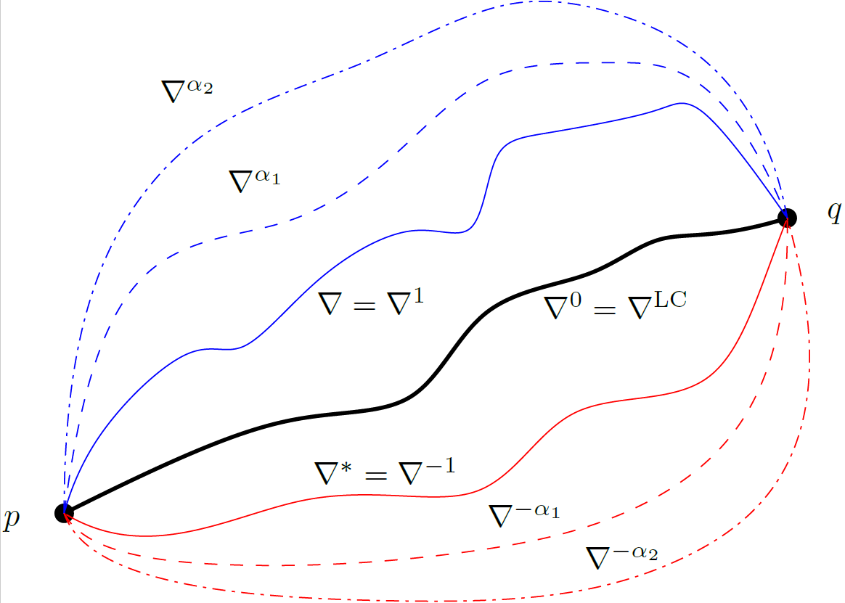
Outline of this talk
Computational geometry for ML!
Introduction to some famous geometric learning machines
Unsupervised learning: Riemannian manifold learning
Supervised learning:
Kernel machines and Hilbert geometry (RKHS)
Deep learning and trajectories on neuromanifolds
Information geometry and information projections:
The dualistic geometric structures
Geometry of interpolation machines:
Double descent learning curves

Slide 3
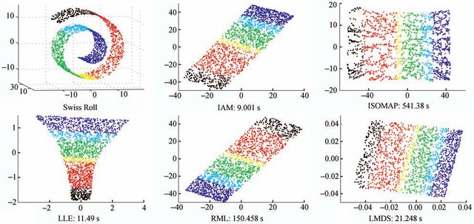
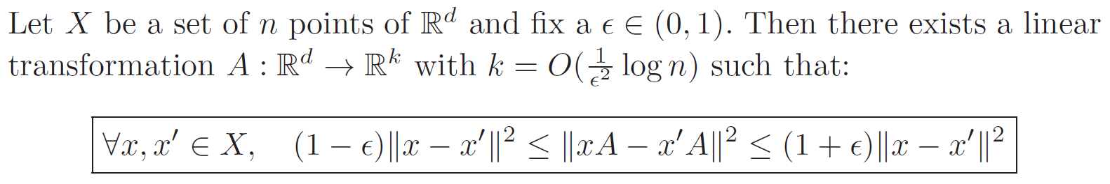
Non-linear versus linear dimension reduction
Many non-linear techniques:
LLE,
ISOMAP
etc.
In very high dimensions, linear dimension projection (curse of dimensionality). Johnson-Lindenstrauss’ theorem (1984)
Introduction to HPC with MPI for Data Science, Springer, 2016

Slide 4
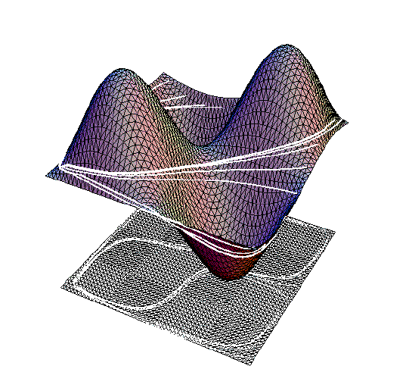
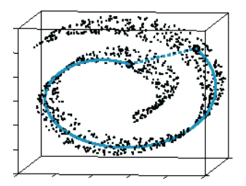
Riemannian manifolds: Extrinsic view vs intrinsic view
Visualized extrinsically as smooth surfaces of the ambient Euclidean space: isometric embedding theorem (Nash embedding theorem)
Isometric
embedding:
Extrinsic geometry
Manifold learning/reconstruction
from data points (Swiss roll)
Intrinsic geometry
Intrinsic geometry versus extrinsic isometric embedding
Notes:
with n ≤ m(3m+11)/2 if M is a compact manifold, or n ≤ m(m+1)(3m+11)/2 if M is a non-compact manifold

Slide 5
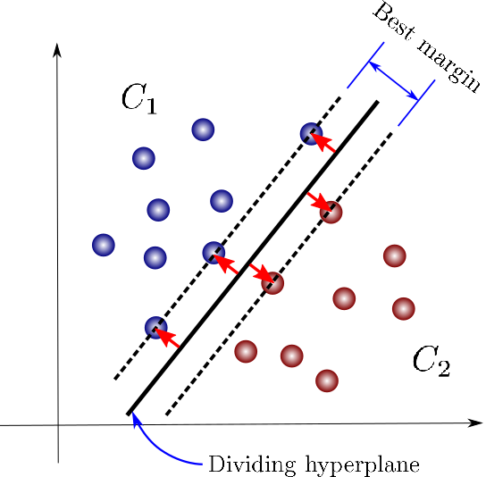
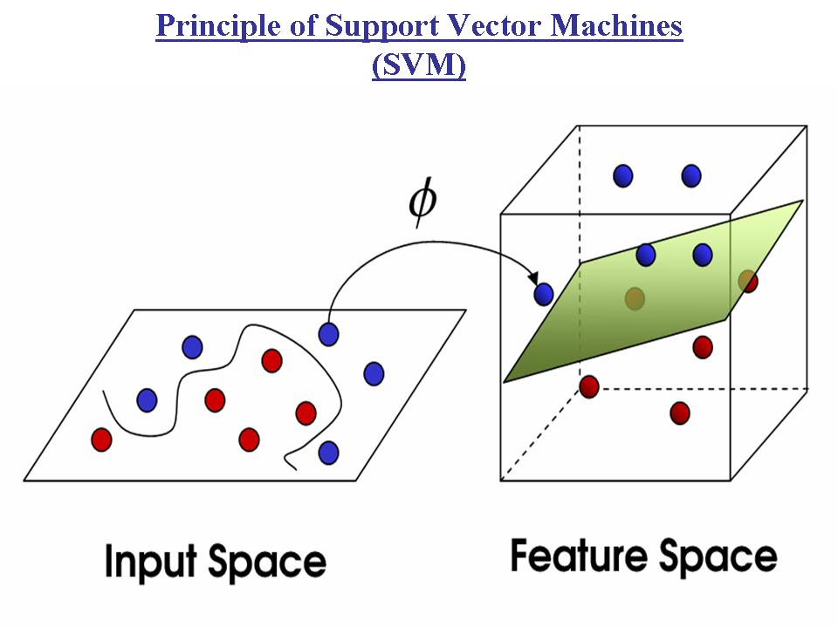
Kernel Support Vector Machines (SVMs)
Linear separator
Non-linear separator
Support vector
Feature map
Inner product
(Hilbert space)
Kernel machines
(RKHS geometry)
1992
1970

Slide 6
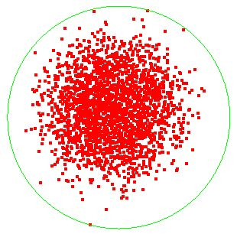
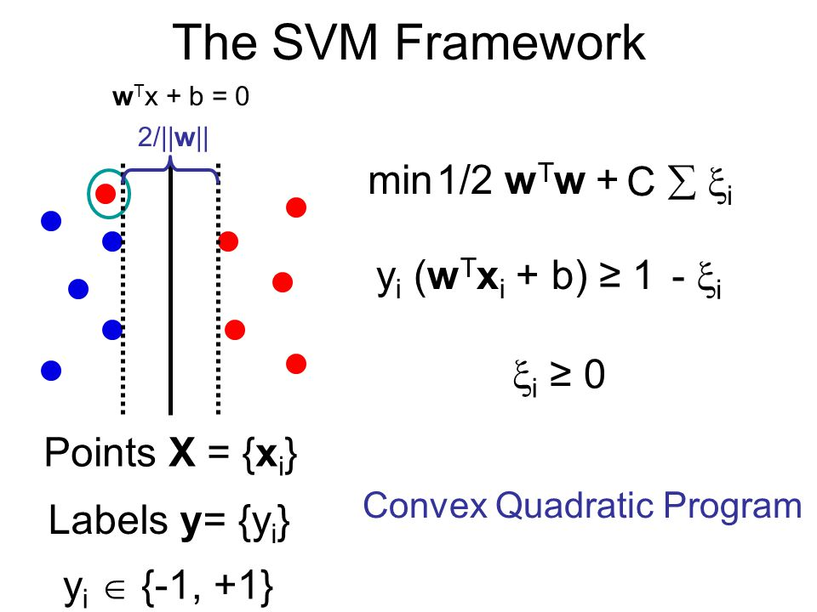
SVM: Dual quadratic program amount to solve for a smallest enclosing ball (= SEB): Computational geometry !
Minimum enclosing ball:
wrt radius or set inclusion
MEB opens new vista: Online SVMs, etc.
Approximating Smallest Enclosing Balls with Applications to Machine Learning, IJGA 2009
Notes:
https://phazcode.gitlab.io/meb/

Slide 7
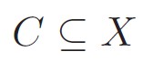
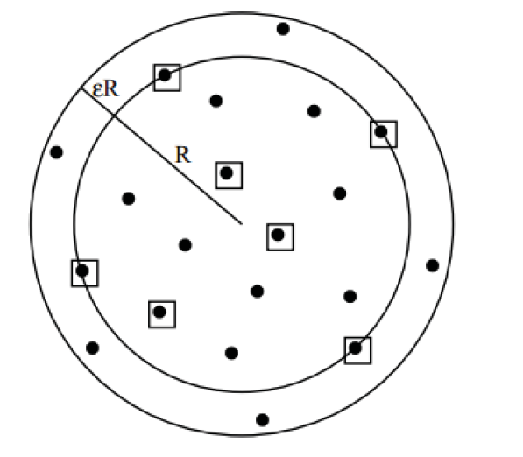
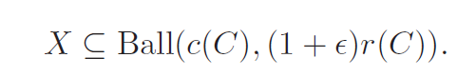
Coresets for Smallest Enclosing Balls and Core VMs
Definition: A coreset is a subset such that
[BC 2002]
Independent of input size n
Independent of dimension d
Only dependent of epsilon ☺
Selected points inside boxes
Apply to finite point sets in infinite-dimensional spaces too!
-> Kernel machines with Core Vector Machines
A note on kernelizing the smallest enclosing ball for machine learning, 2017
Introduction to HPC with MPI for Data Science, Springer, 2016

Slide 8
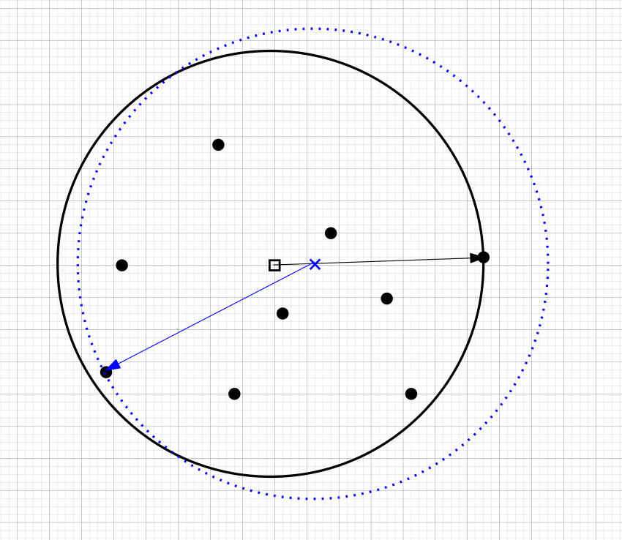
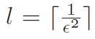
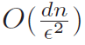
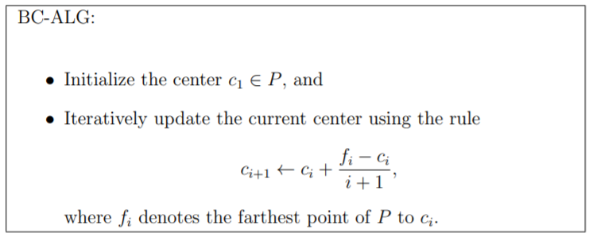
Computing a coreset for the Smallest Enclosing Balls
Extremely simple algorithm ☺ !
#iterations:
Running time:
On approximating the Riemannian 1-center. Comput. Geom. 46(1): 93-104 (2013)
Approximating Covering and Minimum Enclosing Balls in Hyperbolic Geometry. GSI 2015

Slide 9
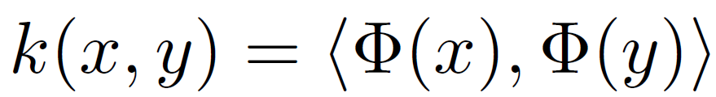
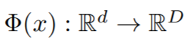

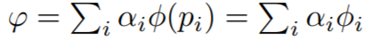
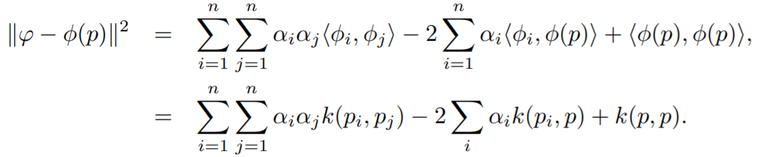
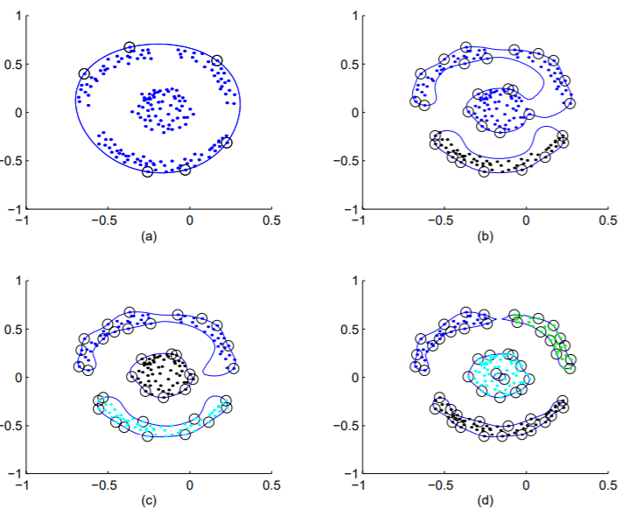
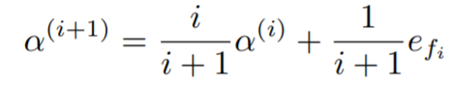
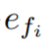
Approximating the kernelized minimum enclosing ball
Kernel
with
feature map
(D may be infinite)
Trick: Encode implicitly the circumcenter of the enclosing ball as a
convex combination of the data points:
Update weights iteratively:
Index of the current farthest point
Applications: Support Vector Data Description, Support Vector Data Description
A note on kernelizing the smallest enclosing ball for machine learning, 2017
Notes:
http://cedric.cnam.fr/vertigo/Cours/ml2/coursAlgosNoyaux.html

Slide 10
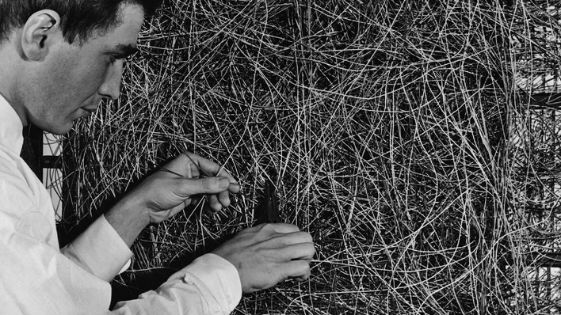
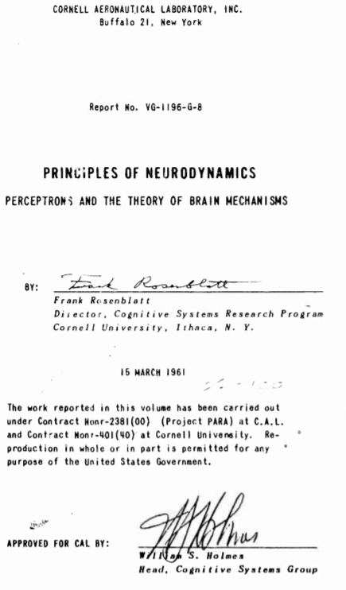
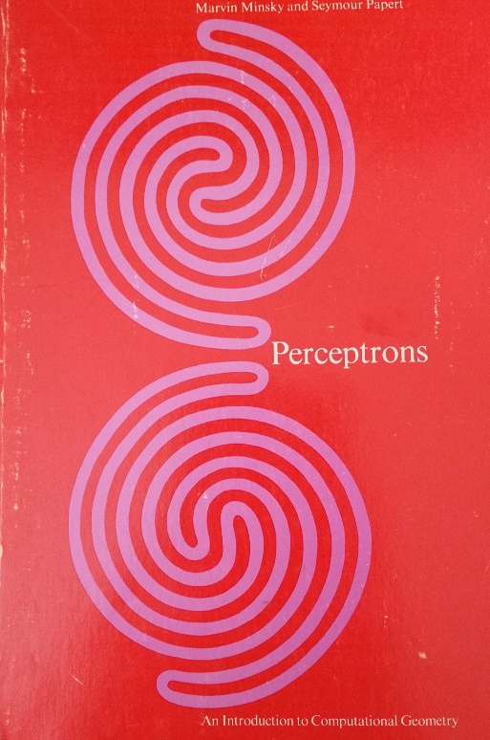
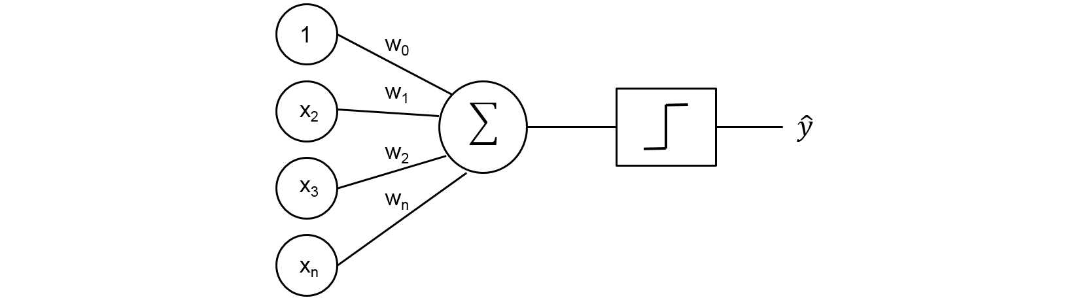
The 1-layer perceptron: linear separator machine
Frank Rosenblatt:
Principles of Neurodynamics, 1962
Marvin Minsky and Seymour Papert:
Perceptrons: An Introduction to Computational Geometry, 1969
Notes:
https://jtsulliv.github.io/perceptron/

Slide 11
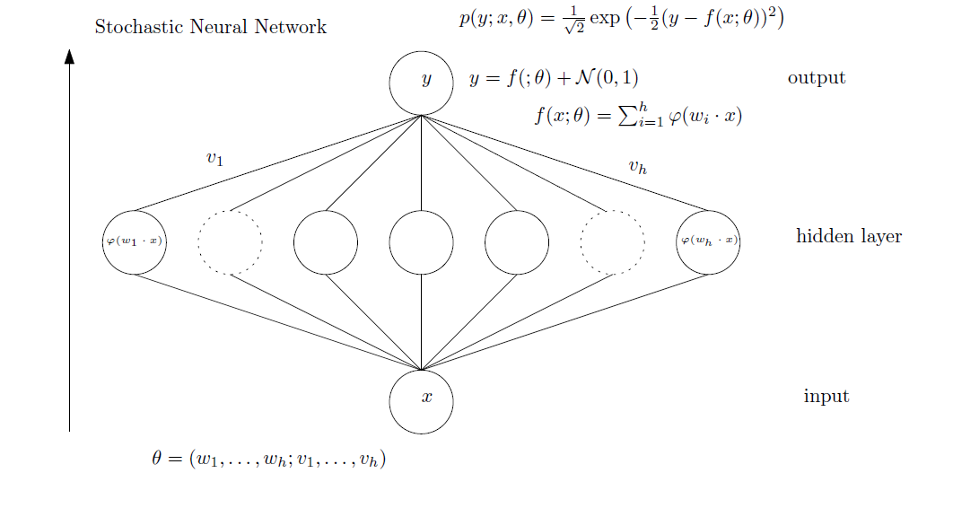
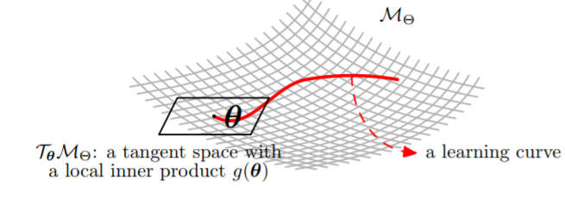
Stochastic MLPs and neuromanifolds
Neurodynamics=
Learning trajectory on the manifold
Parameter space
Hidden layers: universal function approximators (post XOR)
Supervised learning: gradient descent + backpropagation

Slide 12
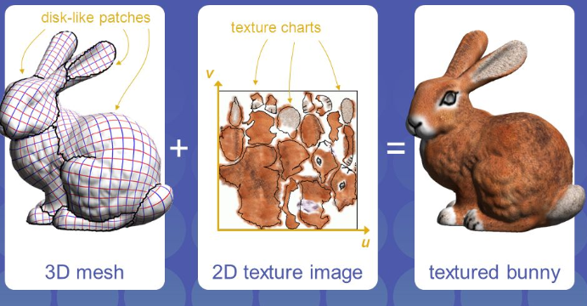
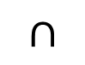
Smooth manifold
Global geometric objects
vs
Local descriptions
in local chart coordinates
M
Locally Euclidean
(homeomorphism)
p
V
U
Atlas= set of charts
Coordinates in charts+transition maps
Φ_{v}
R^{n}
Φ_{u}
Φ_{u} (U V)
$$∩$$
Φ_{v}(V)
Φ_{u}(U)
Φ_{uv}
UV mapping in computer graphics

Slide 13
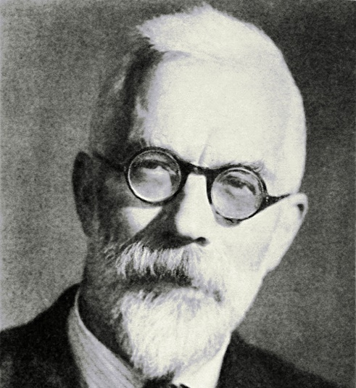

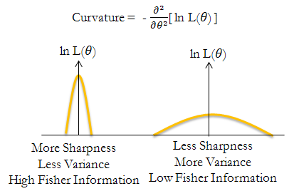
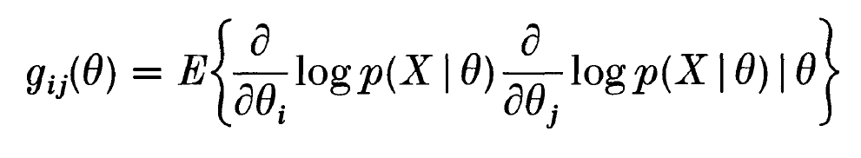
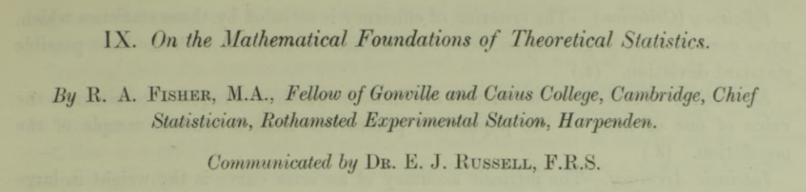
Fisher information matrix (FIM)
$\text{g}\text{(}\text{ξ}\text{)}\text{=}\text{E}\text{ξ}$[$\frac{∂}{∂\text{ξ}i}log⁡(p\text{ξ}\text{)}$ $\frac{∂}{∂\text{ξ}j}log⁡(p\text{ξ}\text{)}$]
g_{ij}(ξ)=$\int{\frac{∂}{∂\text{ξ}i}}log⁡(p\text{ξ}$(x))$\frac{∂}{∂\text{ξ}j}log⁡(p\text{ξ}\text{(}\text{x}\text{))}\text{p}\text{ξ}\text{(}\text{x}\text{)}\text{dx}$
Sir Ronald Fisher
FIM is positive-semidefinite, positive-definite for regular models
1922
Notes:
https://royalsocietypublishing.org/doi/pdf/10.1098/rsta.1922.0009

Slide 14
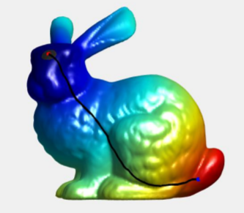
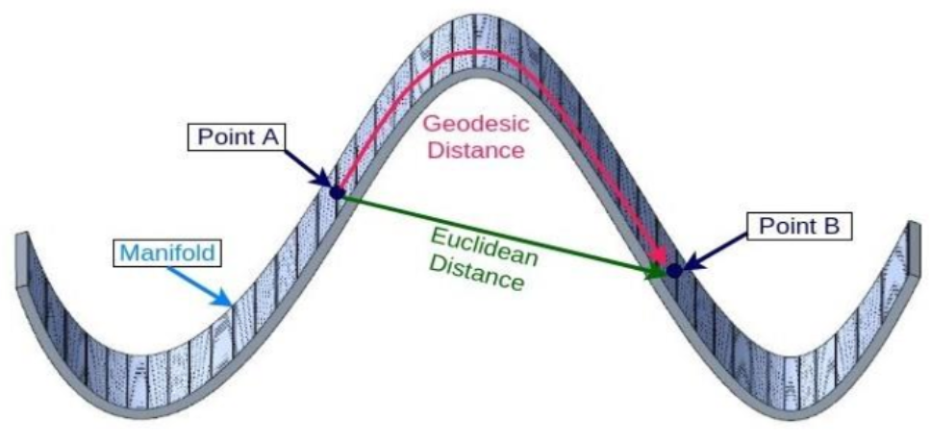
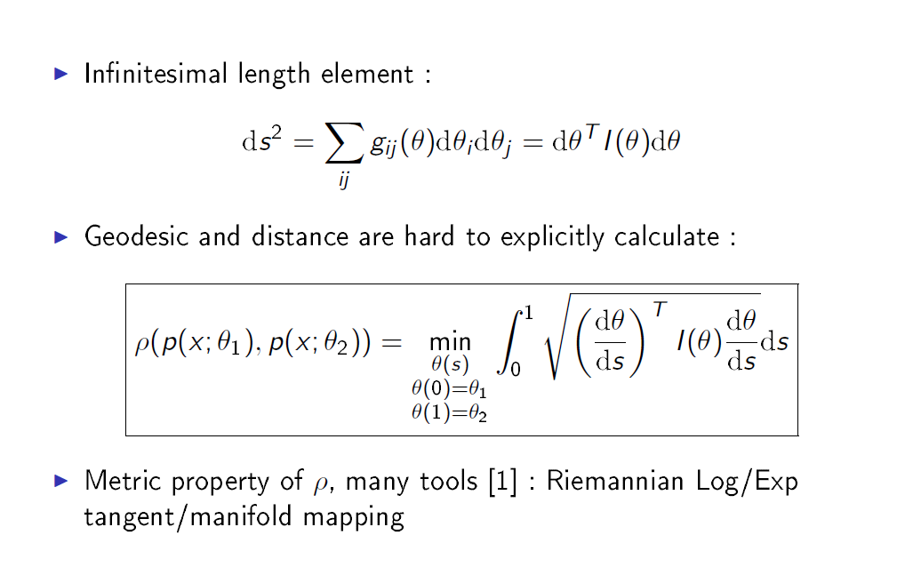
Fisher-Rao geometry and geodesic distance
Fisher information metric (FIM)
independent to reparameterization of θ
Riemannian geodesics locally minimize lengths

Slide 15
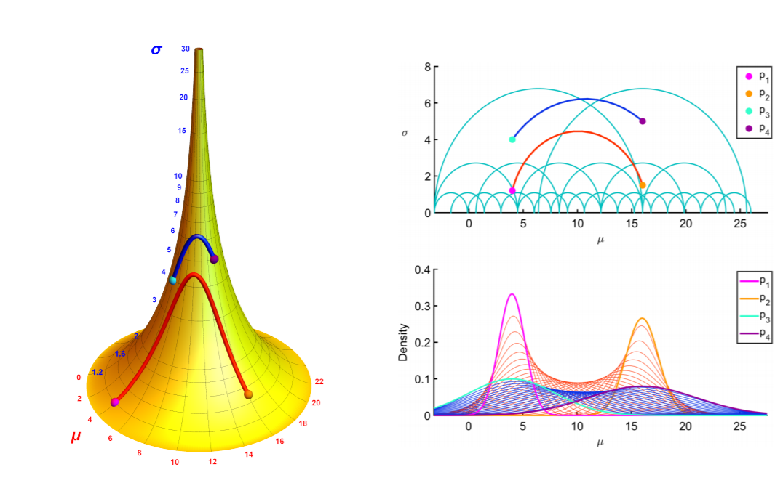
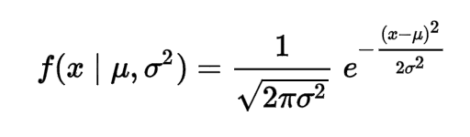
Riemannian geometry of normal distributions equipped with FIM: hyperbolic geometry
Metric tensor:
Measure vector lengths, angles on tangent space
Pseudo-sphere
(negative curvature -1/2)
Pattern recognition in nuclear fusion data by means of geometric methods in probabilistic spaces, 2017

Slide 16
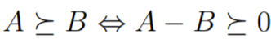
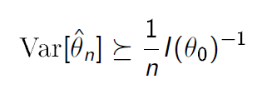
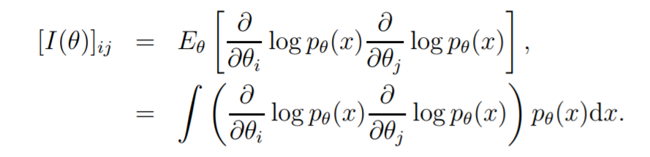
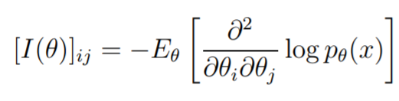
Cramer-Rao lower bound: Inverse of Fisher information
Löwner partial ordering on positive-semi-definite matrices:
Accuracy of estimator
depends on true parameter
CRLB Theorem:
Under regularity conditions:
Cramer-Rao lower bound and information geometry. Connected at Infinity II, 2013.

Slide 17
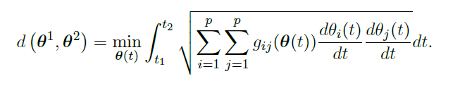
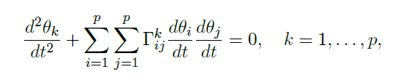
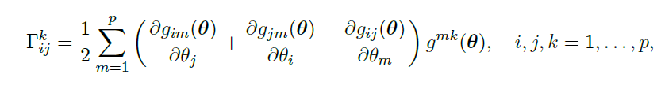
Calculating Rao’s distance is often untractable
Need to solve the Ordinary Differential Equation (ODE) for find the geodesic (but trivial in 1D):
Need to integrate the infinitesimal length elements along the geodesics…
No closed-form Fisher-Rao distance between multivariate normals!
-> geodesic shooting (BVP: boundary value problem, IVP: initial value problem)
Notes:
https://golem.ph.utexas.edu/category/2018/05/the_fisher_metric_will_not_be.html
http://robotics.snu.ac.kr/fcp/files/_pdf_files_publications/201312_DTI%20Segmentation.pdf
https://www.researchgate.net/publication/282538992_Geodesic_Hypothesis_Testing_for_Comparing_Location_Parameters_in_Elliptical_Populations

Slide 18
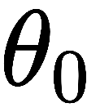
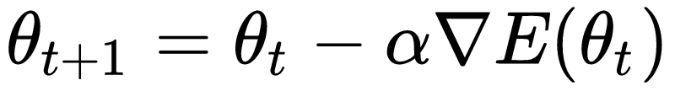
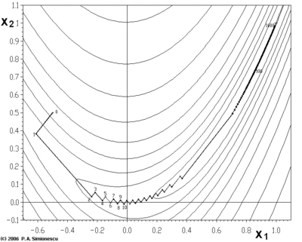
Ordinary steepest gradient descent method
Using the Fisher Information Matrix without geodesics?
Iterative optimization algorithm
Start from an initial parameter value
Update iteratively the current parameter using a learning rate α (step size) and the gradient of the energy function:
First-order optimization method
Zig-zag local minimum convergence
Stopping criterion
Similarly, maximization with hill climbing, steepest ascent

Slide 19


Steepest descent in a Riemannian space: The natural gradient
The steepest descent direction of E(θ) in a Riemannian space is given by
Type checking:
Contravariantform of the
ordinary gradient
Learning rate
Computing the inverse of the Fisher information matrix is tricky!
Amari, Shun-Ichi. "Natural gradient works efficiently in learning." Neural computation 10.2 (1998): 251-276.
Notes:
-\tilde{\nabla} E(\theta)=-G^{-1}(\theta) \nabla E(\theta)
https://ermongroup.github.io/blog/geo/
https://ipvs.informatik.uni-stuttgart.de/mlr/marc/notes/gradientDescent.pdf

Slide 20
Pros and cons of natural gradient
Pros:
Invariant (intrinsic) gradient (at infinitesimal scale/ODE)
Not trapped in plateaus (close to degenerate FIM)
Achieve Fisher efficiency in online learning
Cons:
Too expensive to compute (no closed-form FIM; need matrix inversion; numerical stability) -> Other Riemannian metrics studied
Degenerate for irregular models (e.g., hierarchical models, Deep learning)
Need to adapt the step size

Slide 21




Relative Fisher Information Matrix (RFIM) and Relative Natural Gradient (RNG) for deep learning
Relative Fisher IM:
Dynamic geometry!
The RFIMs of single neuron models, a linear layer, a non-linear layer, a soft-max layer, two consecutive layers all have simple RFIM closed form solutions
Relative Fisher Information and Natural Gradient for Learning Large Modular Models (ICML'17)

Slide 22


Dualistic structures of Information geometry and Information projections (may seem at first counterintuitive)
An elementary introduction to information geometry, arXiv:1808.08271

Slide 23






An essential concept: Affine Connection $∇$
Define how to “parallel transport” a vector from one tangent plane to another tangent plane by infinitesimally parallel shifting it along a curve (thus generally depend on the curve)
$∇$-geodesics = autoparallel curves
V_{p}=V(p)
V(q)
q
$$∇$$
$$\dot{γ}$$
γ
Elie Joseph Cartan
(1869-1951)
https://arxiv.org/abs/1808.08271
Notes:
Discrete Connection and Covariant Derivative for Vector Field Analysis and Design
http://genderi.org/introduction-to-general-relativity-lectures-by-pietro-fr.html

Slide 24






Curvature of a connection $∇$
Osculating circle
Sectional
curvatures
Cylinder is flat:
Parallel transport is
path-independent
Sphere has constant curved curvature:
Parallel transport is path-dependent
Notes:
https://images.math.cnrs.fr/Visualiser-la-courbure.html?lang=fr

Slide 25








Dual exponential/mixture affine connections
Historically, built the e-connection (exponential) and
m-connection (mixture) for statistical models
Log-likelihood
e-connection
m-connection
May not need distances here
DUAL CONNECTIONS wrt. the
Fisher information (Riemannian) metric

Slide 26


Dualistic structure of the Gaussian manifold
∇: e-connection, flat
∇*:m-connection, flat
Dually flat space!
(both connections flat)
M-geodesic
E-geodesic

Slide 27

In a Dually flat space, dual Pythagoras’ theorem
Bregman manifold induced by a
convex function
Two (affine) coordinate systems coupled by Legendre-Fenchel transformation
Two dually flat connections with respect to the metric tensor
Canonical distance = Bregman divergence induced by convex generator F
Generalize Euclidean space, ☺ very practical ☺ for computing!

Slide 28



Geodesic triangles in Bregman manifolds
3 vertices define 6 geodesic edges from which
8 geodesic triangles can be built, defining 18 interior angles
Geodesic triangle
with two right angles
(geometry is NOT CONFORMAL)
Geometry induced by dual convex potentials
https://arxiv.org/abs/1910.03935

Slide 29

Proof using the Pythagoras’ theorem, min. distance
Recalling projections in Euclidean geometry….
Orthogonality and uniqueness of projection
Guaranteed unique projection
Non-unique projection

Slide 30


On uniqueness of projections in dually flat spaces
Projection to a submanifold
with respect to a connection
In dually flat spaces, uniqueness of projections when

Slide 31



Maximum likelihood estimator for an exponential family as an information m-projection
Exponential Family Manifold (EFM) is e-flat
Observed point
KL=
Relative entropy
What is an information projection?, Notices AMS 65.3 (2018)

Slide 32



MaxEnt as an information e-projection
MaxEnt linear constraints define a m-flat
Pythagoras’ theorem (Fisher orthogonality)
What is an information projection?, Notices AMS 65.3 (2018)

Slide 33


Geometric framework yields interpretations of MLE/MaxEnt of KL divergence minimizations as information projections (and uniqueness proofs)
MaxEnt (with prior q)
e-projection on m-flat
Maximum Likelihood Estimate
m-projection on e-flat

Slide 34


Divergences: Statistical (oriented) distances or smooth parametric distances
In information theory, relative entropy called Kullback-Leibler divergence
KLD can be extended to f-divergences
Plug f(u)=-log(u) and the f-divergence is the KLD

Slide 35


Classes of distances: Csiszar’s f-divergence
Function f convex, strictly convex at 1, with f(1)=0
On the chi square and higher-order chi distances for approximating f-divergences, IEEE SPL 2013

Slide 36


The Fisher information matrix and f-divergences
Fisher Information Metric (FIM): Fisher Riemannian metric
Infinitesimally, the Kullback-Leibler or f-div related to the FIM

Slide 37



Invariant divergence = f-divergences
Lump or coarse-bin a separable distance, and ask for
information monotonicity
Theorem: The only monotone separable divergences are f-divergences
(except for the curious case of binary alphabets),
f-divergences are invariant by diffeormorphisms of the sample space

Slide 38



Dual connections from any divergence!
$(M,{}_{D}^{}g,{}_{D}^{}∇,$ ${}_{D}^{}∇$*)
Dual connections from any smooth parametric distance,
called a (parameter) divergence D: D is not necessarily symmetric
a tensor metric g: g_{ij}(p_{ξ})=$\frac{∂}{∂\text{ξ}i1}\frac{∂}{∂\text{ξ}j}$₂D(p_{ξ1},p_{ξ2})|_{ξ1=ξ2=ξ}
a torsion-less affine connection $∇$:
Γ_{ijk}(p $ξ$)$=−\frac{∂}{∂\text{ξ}i1}\frac{∂}{∂\text{ξ}j2}\frac{∂}{∂\text{ξ}k2}$D(p_{ξ1},p_{ξ2})|_{ξ1=ξ2=ξ}
D*(p_{ξ1},p_{ξ2})$=\text{D}\text{(}\text{p}\text{ξ}\text{2}\text{,}\text{p}\text{ξ}\text{1}\text{)}$
Dual divergences
and dual connections
Symmetric divergences yields the same connection:
The Levi-Civita connection

Slide 39

Which geometry is best suited for clustering normalized histograms?
Bag of words

Slide 40




Fisher-Rao geometry of the categorical distribution (standard simplex)
Trinomial (trinoulli)
Fisher information metric:
Square root embedding
(Hotelling)-Fisher-Rao distance:
Embedding to the sphere positive orthant
Pattern Learning and Recognition on Statistical Manifolds: An Information-Geometric Review, SIMBAD 2013
Clustering in Hilbert simplex geometry, arXiv:1704.00454

Slide 41

Hilbert log cross-ratio metric
Geodesics are straight lines but not unique
Finsler geometry!
Clustering in Hilbert simplex geometry. CoRR abs/1704.00454 (2017)

Slide 42


Hilbert log cross-ratio metric for the standard simplex

Slide 43

Experiments
With
K-means
Clustering in Hilbert simplex geometry. CoRR abs/1704.00454 (2017)

Slide 44


Sailing on a sea of distances:
Which distance is suitable?
Which loss function to minimize?
Which “metric” to evaluate?
…
Are there first principles?

Slide 45


Classes of distances: Bregman divergence
Bregman divergence between parameters for a strictly convex and differentiable convex function F
The canonical divergence of dually flat spaces
Geometric design
Unify squared Euclidean geometry
and geometry of information theory
Mining matrix data with Bregman matrix divergences for portfolio selection."Matrix Information Geometry. Springer, Berlin, Heidelberg, 2013. 373-402.

Slide 46



Jensen difference/Jensen divergence (Burbea-Rao)
Geometric design
Introduced by Burbea and Rao
Vertical gap induced by Jensen inequality
Asymptotic scaled Jensen divergence amount to a Bregman or reverse Bregman divergence
The Burbea-Rao and Bhattacharyya centroids." IEEE Transactions on Information Theory 57.8 (2011): 5455-5466.
Bregman chord divergence: https://arxiv.org/abs/1810.09113
A family of statistical symmetric divergences based on Jensen's inequality, arXiv:1009.4004
Notes:
J_{\alpha}^{F}(\theta_1 : \theta_2)=\left\{\begin{array}{ll}{\frac{1}{\alpha(1-\alpha)} J^{\prime F}(\theta_1: \theta_2)} & {\alpha \neq\{0,1\}} \\ {B_{F}(\theta_1: \theta_2)} & {\alpha=1} \\ {B_{F}(\theta_2 : \theta_1)} & {\alpha=0}\end{array}\right.

Slide 47


Classical wisdom of machine learning: The bias-variance tradeoff…
We used to think: Do not overfit
for better generalization!
Test sample for evaluating
generalization error

Slide 48

Modern view of machine learning: The age of Interpolation machines!
Ok, let us do zero-training error! (Gaussian processes or Neural Networks)
But to have good models, let us set Occam’s razor principle to choose the smoothest interpolating function
Neural networks
perform well even when overparameterizated
Deep Neural Networks as Gaussian Processes, https://arxiv.org/abs/1711.00165

Slide 49

Modern view of machine learning:
The double descent view/regime of models
Semi-Riemannian geometry of
neuromanifold
and learning
trajectories
Reconciling modern machine learning practice and the bias-variance trade-off, https://arxiv.org/abs/1812.11118
Lightlike Neuromanifolds, Occam's Razor and Deep Learning, 1905.11027

Slide 50
Concluding remarks
Computational information geometry
for ML+AI!
From the very beginning, computational geometry played
a major role in machine learning!
Geometry: Design guiding principle promoting insightful intuition
and science of invariance. Meaning of distances.
Dualistic structure of information geometry + information projection:
Role of Fisher information matrix/metric in ML (Fisher kernel, etc.)
Theory of communication between data/(sub)models and models
(but may seem at first counterintuitive)

Slide 51



Geometric Science of Information (GSI)
Co-organized every 2 years since 2013
180 participants, August, Toulouse, France, 2019
Joint Structures and Common Foundations of Statistical Physics, Information Geometry and Inference for Learning
26th July to 31st July 2020
Ecole de Physique des Houches

